Slide 1
Container Packing Problem
With Weight-Coded
Genetic Algorithm
Ahmad Hashemi
30.06.2017

Slide 2
Index
Weight-Coded GA
statistical concept
Heuristic
Genetic Algorithm
Applied GA operators
The Constraint Termination
Packing Algorithm
Advantages of Weight-Coded GA

Slide 3





Weight-Coded GA
A solution to the optimization problem is represented by a vector of weights that modifies the original problem solution.
Upgrading: Orientation Array
Each candidate solution
(chromosome)
relative value of
Each box
$$=U$$
Biasing
strength

Slide 4

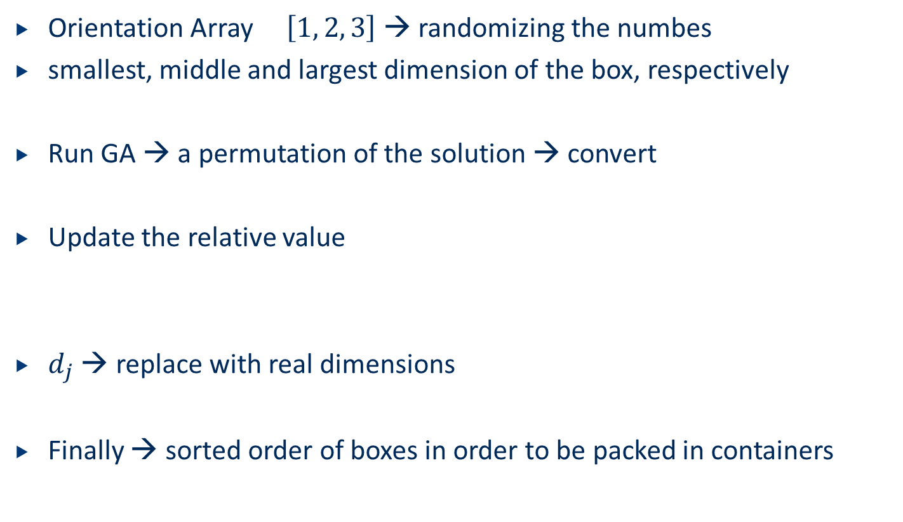
Weight-Coded GA
Orientation Array $\left[1, 2, 3\right]$ → randomizing the numbes
smallest, middle and largest dimension of the box, respectively
Run GA → a permutation of the solution → convert
Update the relative value
$d_{j}$ → replace with real dimensions
Finally → sorted order of boxes in order to be packed in containers

Slide 5
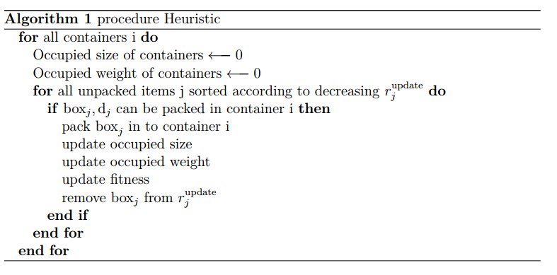
Fit Algorithm

Slide 6
Packing Algorithm
Block-and-layer method
starting from the origin along the X-axis till there is no more space for a new box → first block
Action point move to the point with coordination of (null , box with the largest width) → new block
there is no more space for a new block → close layer
Action point = (null ,null, box with the largest height) → new layer
there is no more space to pack a new layer → container is full

Slide 7
Genetic Algorithm
Genetic Algorithm
Applied GA operators
Elite
Corssover double point
SwapMutate
Customized Operator \textendash Gene Mutate Operator
Using previous operators, dimension arrays will not be evolved along execution of the GA
Developing a new mutation operator
The Constraint Termination
the GA is adjusted to evolved for 400 generations
obtaining a better solution compared with the first method

Slide 8
Advantages of Weight-Coded GA
2 methods to solve the CP problem with GA
direct encoding
chromosomes containing genes, which indicate which box should be packed in which container
Weight-Coded GA Vs. direct encoding
Direct encoding → infeasible solutions must be handled
a repair algorithm
adding a penalty term to FF
Weight-Coded GA → operators is used to generate new chromosome that contain always valid permutation

Slide 9
questions
Thank you for your attention
Any questions?

Slide 10
Literature
Günther R. Raidl. The multiple container packing problem: A genetic algorithm approach with weighted codings. SIGAPP Appl. Comput. Rev., 7(2):22–31, March 1999.
Günther Raidl and Gabriele Kodydek. Genetic algorithms for the multiple container packing problem. In Parallel Problem Solving from Nature, pages 875–884. Springer, 1998.

